Slide 1
Searching Technique

Slide 2
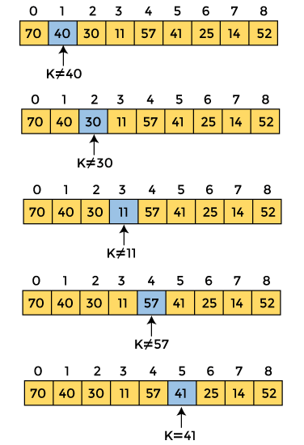
Linear Search Algorithm
Linear Search is defined as a sequential search algorithm that starts at one end and goes through each element of a list until the desired element is found, otherwise the search continues till the end of the data set. It is the easiest searching algorithm

Slide 3
// C++ Recursive Code For Linear Search
#include <iostream>
using namespace std;
int linearsearch(int arr[], int size, int key)
{
if (size == 0) {
return -1;
}
else if (arr[size - 1] == key) {
// Return the index of found key.
return size - 1;
}
else {
int ans = linearsearch(arr, size - 1, key);
return ans;
}
}
// Driver's Code
int main()
{
int arr[5] = {5, 15, 6, 9, 4 };
int key = 4;
// Function call
int ans = linearsearch(arr, 5, key);
if (ans == -1) {
cout << "The element " << key << " is not found."
<< endl;
}
else {
cout << "The element " << key << " is found at " << ans << " index of the given array." << endl;
}
return 0;
}

Slide 4
The steps used in the implementation of Linear Search are listed as follows -
First, we have to traverse the array elements using a for loop.
In each iteration of for loop, compare the search element with the current array element, and -
  If the element matches, then return the index of the corresponding array element.
  If the element does not match, then move to the next element.
If there is no match or the search element is not present in the given array, return -1.

Slide 5
Algorithm
Linear_Search(a, n, val) // 'a' is the given array, 'n' is the size of given array, 'val' is the value to search
Step 1: set pos = -1
Step 2: set i = 1
Step 3: repeat step 4 while i <= n
Step 4: if a[i] == val
set pos = i
print pos
go to step 6
[end of if]
set ii = i + 1
[end of loop]
Step 5: if pos = -1
print "value is not present in the array "
[end of if]
Step 6: exit

Slide 6
Linear Search complexity
1. Time Complexity
Best Case Complexity - In Linear search, best case occurs when the element we are finding is at the first position of the array. The best-case time complexity of linear search is O(1).
Average Case Complexity - The average case time complexity of linear search is O(n).
Worst Case Complexity - In Linear search, the worst case occurs when the element we are looking is present at the end of the array. The worst-case in linear search could be when the target element is not present in the given array, and we have to traverse the entire array. The worst-case time complexity of linear search is O(n).
Case | Time Complexity
Best Case | O(1)
Average Case | O(n)
Worst Case | O(n)
2. Space Complexity
The space complexity of linear search is O(1).
Space Complexity | O(1)

Slide 7
Binary Search Algorithm
Binary search is the search technique that works efficiently on sorted lists. Hence, to search an element into some list using the binary search technique, we must ensure that the list is sorted.
Binary search follows the divide and conquer approach in which the list is divided into two halves, and the item is compared with the middle element of the list. If the match is found then, the location of the middle element is returned. Otherwise, we search into either of the halves depending upon the result produced through the match.
NOTE: Binary search can be implemented on sorted array elements. If the list elements are not arranged in a sorted manner, we have first to sort them.

Slide 8
Algorithm
Binary_Search(a, lower_bound, upper_bound, val) // 'a' is the given array, 'lower_bound' is the index of the first array element, 'upper_bound' is the index of the last array element, 'val' is the value to search
Step 1: set beg = lower_bound, end = upper_bound, pos = - 1
Step 2: repeat steps 3 and 4 while beg <=end
Step 3: set mid = (beg + end)/2
Step 4: if a[mid] = val
set pos = mid
print pos
go to step 6
else if a[mid] > val
set end = mid - 1
else
set beg = mid + 1
[end of if]
[end of loop]
Step 5: if pos = -1
print "value is not present in the array"
[end of if]
Step 6: exit

Slide 9
// C++ program to implement iterative Binary Search
#include <bits/stdc++.h>
using namespace std;
int binarySearch(int arr[], int l, int r, int x)
{
while (l <= r) {
int m = l + (r - l) / 2;
// Check if x is present at mid
if (arr[m] == x)
return m;
// If x greater, ignore left half
if (arr[m] < x)
l = m + 1;
// If x is smaller, ignore right half
else
r = m - 1;
}
// if we reach here, then element was
// not present
return -1;
}

Slide 10
int main(void)
{
int arr[] = { 2, 3, 4, 10, 40 };
int x = 10;
int n = sizeof(arr) / sizeof(arr[0]);
int result = binarySearch(arr, 0, n - 1, x);
(result == -1)
? cout << "Element is not present in array"
: cout << "Element is present at index " << result;
return 0;
}

Slide 11
Analysis of input size at each iteration of Binary Search:
At Iteration 1:
Length of array = n
At Iteration 2:
Length of array = n/2
At Iteration 3:
Length of array = (n/2)/2 = n/2²
Also, we know that after k iterations, the length of the array becomes 1 Therefore, the Length of the array
n/2^{k} = 1
=> n = 2^{k}
Applying log function on both sides:
=> log₂n = log₂2^{k}
=> log₂n = k * log₂2
As (log_{a} (a) = 1) Therefore, k = log₂(n)
Therefore, after Iteration k:
Length of array = n/2^{k}

